Slide 1

MYCOPLASMA SIDEKICK™
Assay Technology & Technical Workflow
Automated DNA extraction • Real-time PCR • Approx. 90-minute workflow*
HUMAN HEALTH DIAGNOSTICS | RESEARCH USE ONLY

Slide 2
Presentation objectives
• Review the SideKick system and cartridge components.
• Walk through the sample-to-result workflow shown in the source document.
• Explain the cartridge’s lysis, DNA-extraction and PCR areas.
• Summarize the internal control, magnetic beads and positive control listed in the source.
• Identify technical details that must be confirmed in the controlled assay instructions.
HUMAN HEALTH DIAGNOSTICS | MYCOPLASMA SIDEKICK™ | RUO
2

Slide 3
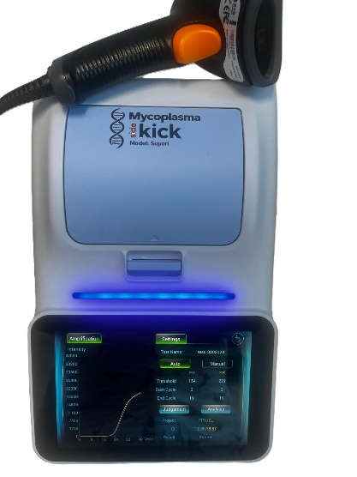
System overview and supplied components
SideKick system
Mycoplasma cartridge
Instrument used to run the cartridge-based assay.
Single assay cartridge prepared with sample and listed reagents.
Internal control
Magnetic beads
Provided with cartridges
Provided with cartridges
Positive control
Purpose of this deck
Technical overview; follow current controlled instructions for use.
Provided with cartridges
HUMAN HEALTH DIAGNOSTICS | MYCOPLASMA SIDEKICK™ | RUO
3

Slide 4
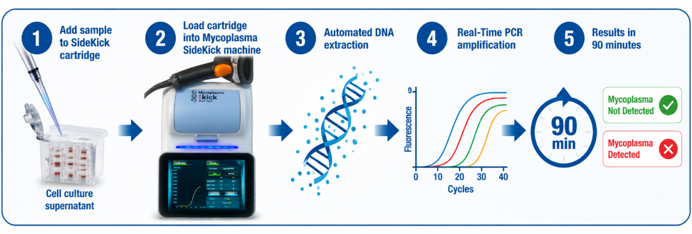
Assay workflow at a glance
HUMAN HEALTH DIAGNOSTICS | MYCOPLASMA SIDEKICK™ | RUO
4

Slide 5
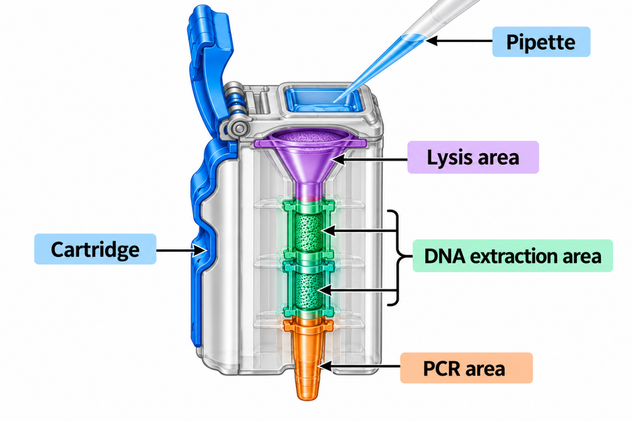
Cartridge preparation: Follow sequence
• Open the cartridge lid.
• Break the sealing film.
• Add sample and mix completely.
• Add internal control.
• Add magnetic beads.
• Pipette 15 times to mix, as shown in the source.
• Close the lid; insert cartridge into the instrument.
Use the current controlled instructions for exact volumes, timing, pipette technique and handling precautions.
HUMAN HEALTH DIAGNOSTICS | MYCOPLASMA SIDEKICK™ | RUO
5

Slide 6
Automated DNA extraction and real-time PCR
Stage A — Lysis
Stage B — DNA extraction
Stage C — Real-time PCR
Cartridge diagram identifies a lysis area.
Automated DNA extraction
Real-time PCR amplification after extraction.
Technical details given in manual
• Target gene / amplicon and primer-probe details
• PCR cycling parameters and fluorescence channels
• Extraction recovery data and inhibition studies
• Thresholding algorithm and result-call rules
HUMAN HEALTH DIAGNOSTICS | MYCOPLASMA SIDEKICK™ | RUO
6

Slide 7
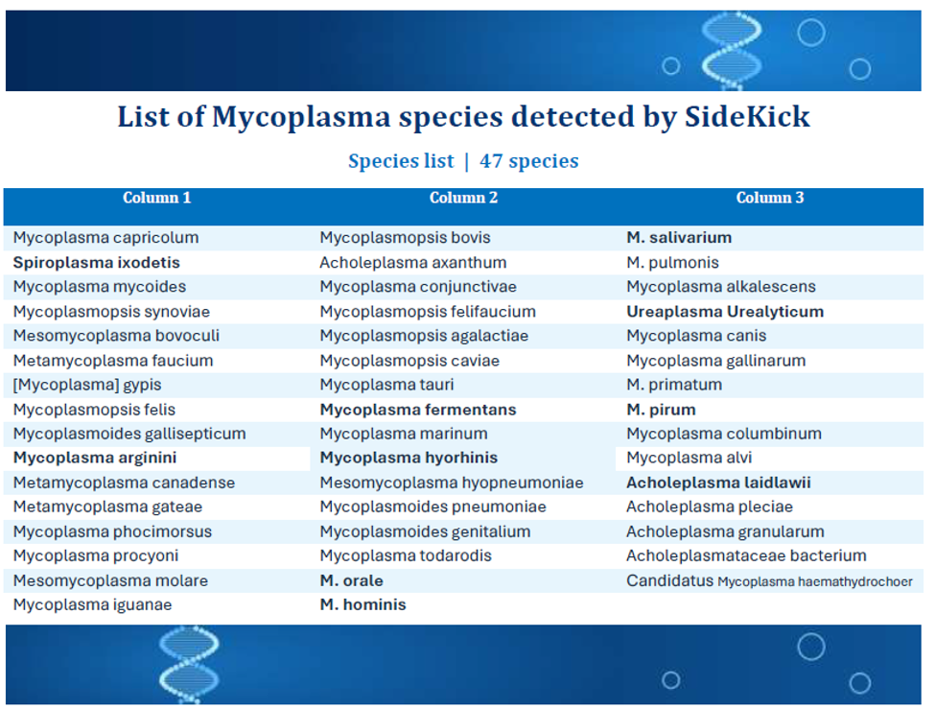
Species Coverage
HUMAN HEALTH DIAGNOSTICS | MYCOPLASMA SIDEKICK™ | RUO
8

Slide 8
Performance characteristics | Detection-limit study
Study design reported in the performance evaluation document
Concentrations tested
Replicates
Reported detection rate
20 tests per concentration; negative control included for each test
100, 10, 5, 2.5 and 1.25 CFU/mL
100% at 100, 10, 5 and 2.5 CFU/mL; 95% at 1.25 CFU/mL
Observed detection rate by nominal concentration
100 CFU/mL
100%
10 CFU/mL
100%
5 CFU/mL
100%
2.5 CFU/mL
100%
1.25 CFU/mL
95%
Interpretation: the report designates 2.5 CFU/mL as the conservative detection-sensitivity claim. The 1.25 CFU/mL level showed 95% detection in this study.
HUMAN HEALTH DIAGNOSTICS | MYCOPLASMA SIDEKICK™ | RUO
10

Slide 9
Performance characteristics | Within-run repeatability
Repeatability evaluation reported 10 tests for reference materials B065-R1 and B065-R2.
Reference material | Channel | Reported CV
B065-R1 | FAM | 3.70%
B065-R1 | ROX | 4.45%
B065-R2 | FAM | 2.27%
B065-R2 | ROX | 4.07%
All four reported coefficients of variation were below 5%. The report describes intra-batch precision as within 5%.
Note: CV values are reproduced from the supplied performance evaluation document; they are not an independent reanalysis of raw data.
HUMAN HEALTH DIAGNOSTICS | MYCOPLASMA SIDEKICK™ | RUO
11

Slide 10
Performance characteristics | Summary of reported data
Detection sensitivity
2.5 CFU/mL
2.5 CFU/mL
Reported as the conservative sensitivity claim; 100% detection at 2.5 CFU/mL in the described 20-replicate study.
Low-level challenge
1.25 CFU/mL
1.25 CFU/mL
95% detection reported at this concentration in the same study.
Repeatability
CV 2.27–4.45%
CV 2.27–4.45%
Four channel/material CVs reported; all below 5%.
Cross-reactivity panel
3 non-target organisms
3 non-target organisms
No signal reported for E. coli, S. aureus or C. albicans in four tests each.
HUMAN HEALTH DIAGNOSTICS | MYCOPLASMA SIDEKICK™ | RUO
12

Slide 11
Technical details available in the manual for the assay
Instrument platform:
Detection principle:
Processing capacity:
Real-time fluorescent PCR with lysis, amplification and qualitative detection integrated with the matching cartridge.
Mycoplasma SideKick system.
Manual specifies individual processing of one sample.
4 sample capacity also present.
User interface:
Real-time monitoring:
Connectivity / reports:
Amplification and fluorescence detection occur in the cartridge without post-processing, as described in the manual.
Manual describes USB and network interfaces and single- or multiple-sample report printing.
7-inch LCD touch screen for parameter setting and result analysis.
HUMAN HEALTH DIAGNOSTICS | MYCOPLASMA SIDEKICK™ | RUO
13

Slide 12
MYCOPLASMA SIDEKICK™
Simplified workflow. Technical clarity. Documented interpretation.
Research Use Only
Not FDA approved. Not suitable for patient testing. Not intended for diagnostic purposes.
Human Health Diagnostics
Before release, verify all product claims, species coverage, assay parameters and interpretation rules against current controlled documentation.

